Slide 1
Performance Management Training
Governor’s Office of Planning and Budget

Slide 2
Purpose of Performance Measures
Performance measures are a key component of Georgia’s budget development process:
Contribute to the analysis of alternative funding scenarios
Provide an understanding of agency program purpose, outcomes, and major activities
Assist in determining how effectively and efficiently programs are operating

Slide 3
Pre-Training Self Assessment Survey

Slide 4
Quality Performance Measures
Garbage in, garbage out
“If the right things are not measured, or are measured inaccurately, those using the data will be misled and bad decisions will likely follow.”- Harry P. Hatry

Slide 5
Performance Management Cycle
Measure Selection
Measure Definition
Data Validation
Performance Assessment
Resources:
Measure Selection Worksheet
Self-Assessment Checklist
Performance Assessment
Today’s Focus:
Measure Definition
Data Validation
Performance Measure Template

Slide 6
Measure Selection
Choosing the Right Measures
Relevant
Meaningful
Clear
Valid
Comprehensive

Slide 7
Measure Selection
Purpose & Goals:
What is the statutory purpose of the program?
What are the goals of the program?
Activities & Clients:
What are the primary activities of the program?
Who is the target population or clients served?
Applying a Logic Model:
What resources do you invest to operate program?
How much and how well do you provide services?
What results do you hope to achieve?

Slide 8
Performance Measure Reviews
The Joint Budget Office Team recently reviewed select program performance measures:
2013 Budget Team Review
2013 Zero-Based Budgeting (ZBB) Review
2014 ZBB Review
OPB will continue to work with agencies to develop relevant, clear, and reliable performance measures.

Slide 9
Performance Management Cycle
Measure Selection
Measure Definition
Data Validation
Performance Assessment

Slide 10
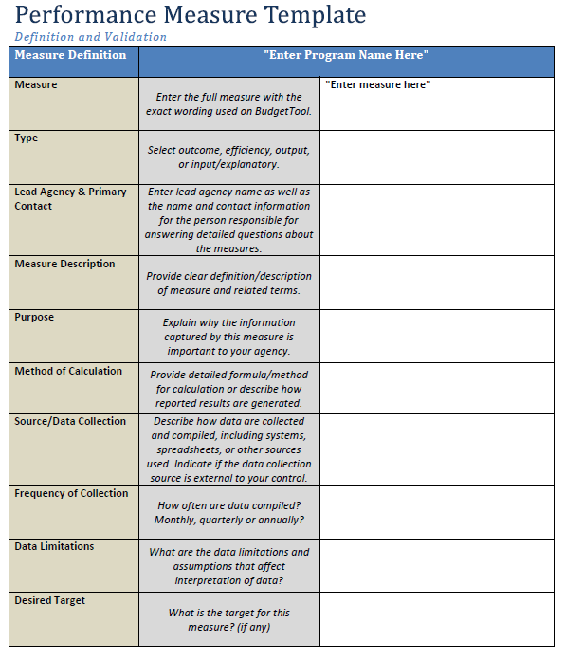
Performance Measure template
Office of Planning and Budget

Slide 11
Performance Measure Template
Definition
Data collection and limitations
Performance benchmarks
Calculation methods
Measure name and type
Purpose

Slide 12
Measure Definition
Measure
Enter the full measure exactly as it appears in Budget Tool.
Type
Select from a dropdown menu.
Output
Efficiency
Outcome
Input/Explanatory

Slide 13
Types of Measures
Output Measures
Measures the amount of service provided.
Efficiency Measures
Measures the amount of resources required to produce a single unit of output.
Outcome Measures
Measures the effectiveness of a service or program on a given variable.
Input/Explanatory Measures
Measures the resources used to provide a service (Input).
Measures the factors or requests received that explain performance (Explanatory).
Answers: How well?
Answers: How much?
Answers: Is anyone better off?

Slide 14
Types of Measures
Output
Number of inspections conducted
Efficiency
Average time to complete an inspection
Outcome
Percentage of inspections found to be compliant
Input / Explanatory
Number of inspectors
Number of requests for inspection received

Slide 15
Measure Definition
Lead Agency & Primary Contact
The contact should be the person who will be responsible for answering detailed follow-up questions about the measure.
Contact’s email and phone number
Name of the primary contact
Name of the agency

Slide 16
Measure Definition
Measure Description
Describe the measure in clear terms so people unfamiliar with the measure or program fully understand it.
Define any terms used in the measure.
Avoid ambiguity, be as specific as possible.
Avoid agency terms, acronyms, and jargon.

Slide 17
Measure Definition
Purpose
Explain why capturing data for this measure is important to the agency.

Slide 18
Measure Definition
Method of Calculation
Provide enough information that an auditor could generate the same results using the same data.
Make note of any recent calculation methodology changes.
Include any tools or software used in the calculation.
Supplement any formulas with explanations.

Slide 19
Measure Definition
Source/Data Collection
Data Limitations
Frequency of Collection
How often does agency compile the data used in the measure?
Include any conditionality associated with the data used for the measure.
Who collects the data?
What tools are used?
How is data compiled?
How is data generated?

Slide 20
Measure Definition
Desired Target
Make note of any recent target changes.
Include the target (if any) as well as how that target was chosen, and why.
Provide explanation if the target is different than national or industry benchmarks.

Slide 21
Measure Definition
Desired Performance
Express desired performance in detailed terms specific to the measure and related to target.
Desired performance may be higher, lower, or equal to target.
Specify any maximum performance threshold or band.

Slide 22
Measure Definition
Benchmark Information
Include any national, state, or industry benchmarks as well as the agency or organization that uses/produces them.

Slide 23
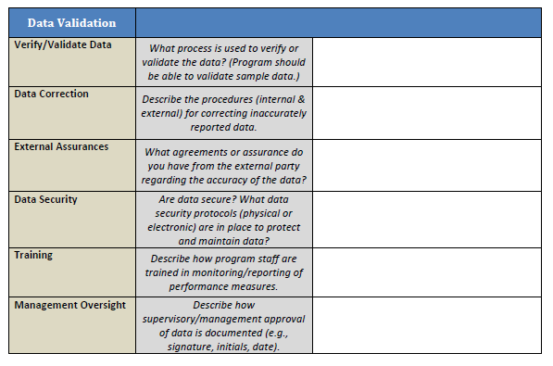
Performance Measure template
Office of Planning and Budget

Slide 24
Performance Measure Template
Data Validation
Data verification and correction
Security Protocols
Training
Management oversight

Slide 25
Data Validation
Verify/Validate Data
Validate data in a manner to assure OPB that the results are replicable.
Perform a check on the data for the measure.

Slide 26
Data Validation
Contact OPB with your data corrections to ensure accurate reporting in Budget Tool.
If the validation process results in revised data, provide a plan for more accurate reporting in the future.
Data Correction

Slide 27
Data Validation
External Assurances
Whether the data is generated or collected externally
Agreements with external parties regarding data validity

Slide 28
Data Validation
Whether or not data is secured/backed up
The location holding your data backups
Data Security
How often data is backed up
List of any security protocols used by agencies

Slide 29
Data Validation
Training
Describe how program staff are trained.
Program staff is trained in monitoring/reporting of performance measures.
Explain who conducts the training and how often training occurs.
Ensure staff have access to documented procedures.

Slide 30
Data Validation
Describe how supervisory/managerial approval of the data is documented.
Management Oversight

Slide 31
Performance Management Cycle
Measure Selection
Measure Definition
Data Validation
Performance Assessment

Slide 32
Performance Assessment
Target Information
Brief Trend Analysis
Improvement Strategies

Slide 33
Performance Assessment
OPB does not currently require targets, however, agency management should have internal targets.
Target Information
What factors led to positive or negative performance?
Was target met within an acceptable variance range?
How can factors preventing target performance be addressed?

Slide 34
Performance Assessment
Brief Trend Analysis
Summarize the trend for the four most recent data points.
Identify possible factors affecting performance.

Slide 35
Performance Assessment
Improvement Strategies
List any current or future strategies for improving performance.
Incorporate strategies into strategic planning processes.
Consider any measure revisions for future performance tracking.

Slide 36
Performance Management Cycle
Measure Selection
Measure Definition
Data Validation
Performance Assessment

Slide 37
Submission Requirements
Performance Measure Template
No further action required – Do Not Submit
Required for ZBB programs and programs reviewed by the Joint Budget Office Team; (Others, for internal use only)
Performance Assessment
Includes Measure Definition and Data Validation
Submit to OPB by Friday, April 5th
At this time, for agency internal use only
Measure Selection Worksheet
Working papers used to assist with performance measure review

Slide 38
Resources
OPB’s Web Site
http://opb.georgia.gov/agency-performance-measures
OPB Staff
Alice Zimmerman
Kathy Kinsella
Allen Fox
Ashley Pandit
Finis Whitt (Intern)

Slide 39
Questions?

Slide 40
Source Material
Performance Measurement: Getting Results
State of Georgia: Governor’s Office of Planning and Budget
Guide to Performance Measure Management
A Quick Guide to Basic Performance Measures
State of Texas: State Auditor’s Office, Legislative Budget Board, and Governor’s Office of Budget, Planning, and Policy
Hatry, Harry P. The Urban Institute Press: Washington DC. 2006. 2nd Edition

